Slide 1
The effect of genotypic diversity on evolution under copper stress in Daphnia pulex and Daphnia pulicaria
PIUMI ABEYNAYAKA

Slide 2
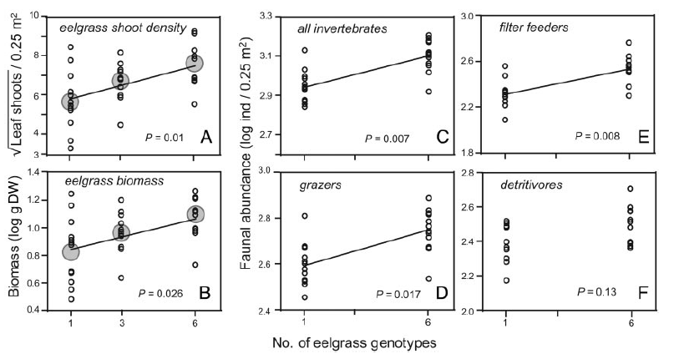
Evidence for ecological effects on genetic diversity
Reusch, T.B.H., et al. (2005) Proceedings of the National Academy of Sciences of the United States of America.

Slide 3
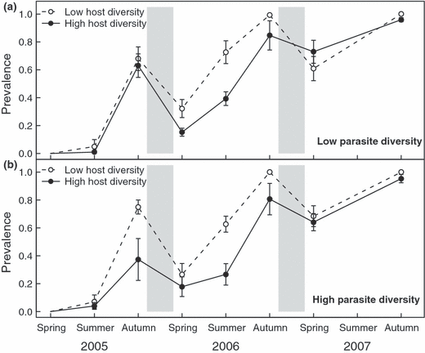
Evidence for ecological effects on genetic diversity
Altermatt, F. and D. Ebert. (2008) Ecology Letters.

Slide 4
Question
How does diversity affect evolutionary changes in Daphnia populations under copper stress?
Or, more specifically:
How does diversity affect changes in population size and allelic richness in Daphnia populations under copper stress?

Slide 5
Hypotheses
Population size
Genotypic diversity will enhance average population size and population stability under both Cu and non-Cu conditions.
Allelic richness
Allelic richness will be reduced in the presence of Cu.
Diversity will buffer against declines in allelic richness under Cu conditions.

Slide 6
Toxicity tests
Preliminary issues:
Determine whether pond and lake Daphnia differ significantly in their copper tolerances.
Determine a copper concentration for use in the experiment: should yield ~10% mortality of lines per habitat.

Slide 7
Preliminary 1:
Range finder test
  8 habitats: 4 ponds and 4 lakes
  1 random isolate from each habitat replicated x2
  5 Cu concentrations
    0, 25, 75, 125, 175 ug/L
  5 neonates per concentration
Eg. Solomon
Habitat
Clone line
1
Replicate
a
b
x 5 neonates
0 25 75 125 175
µg Cu/ L

Slide 8
Preliminary 2:
Acute toxicity test
All 12 habitats: 5 lakes, 7 ponds
2 lines per habitat
2 replicates per line
8 Cu concentrations
  A no copper control + 7
  Determined post range-finder
  Might need to expose pond and lake daphnia to different ranges
5 neonates per concentration
10% mortality per lines
Eg. Solomon
Habitat
2
Clone line
1
Replicate
a
b
a
b
x 5 neonates
Eg.
0 145 150 155 160 165 170 175
µg Cu/ L

Slide 9
Experimental design:
Tank Set-up
 | No diversity (monoculture) |  |  | Low diversity |  |  | High diversity
 | Tank pair 1 | Tank pair 2 | Tank pair 3 | Tank pair 4 | Tank pair 5 | Tank pair 6 | Tank pair 7 | Tank pair 8 | Tank pair 9
No copper | A | B | C | ABC + DEF | ABC + GHI | ABC + JKL | A-L (12) + M-X (12) | A-L + Y-JJ (12) | A-L + KK-UU (12)
Copper | A | B | C | ABC + DEF | ABC + GHI | ABC + JKL | A-L (12) + M-X (12) | A-L + Y-JJ (12) | A-L + KK-UU (12)

Slide 10
Experimental Design: Choosing lines
Library: 16 habitats (8 ponds and 8 lakes) - Illinois, Michigan, Minnesota, and Ontario
  Eliminate 4 habitats
  →12 habitats: 7 ponds (Illinois, Ontario, Michigan), 5 lakes (Illinois, Ontario)
Ponds vs. lakes?
  Depends on tox test results
Total 48 genotypes selected with an even distribution across all habitats
  Choose subset of 12 for low diversity randomly
  Choose subset of 3 for monocultures randomly

Slide 11
Running the experiment
Month | Week # | Activity | Genetic analysis
Dec | -4 | Culture daphnia
 | -1 | Fill tanks with FLAMES
Jan | 0 | Seed 48 juveniles into each tanks – stagger over a few days | Select 48 individuals in proportions corresponding to tanks. 10 microsatellite marker loci.
 | 1.5 | Allow to reach carrying capacity | Sample 48 indiv. per tank.
 | 2 | Spike with [Cu] determined by tox test
Jan/ Feb | 2-7 | Count weekly: sample each tanks 6 times with scintillation vials Change FLAMES bi-weekly Monitor pH/temperature Monitor change in FLAMES volume by weighing tanks
Feb | 8 | Stop experiment | Sample as many indiv. as available.

Slide 12
Analysis
Population size
Average population size per tank over time
Coefficient of variance per tank to estimate population stability through time
Use MANOVA? Or split-plot ANOVA?
Genetic analysis
Measure allelic richness initially, at carrying capacity, and at conclusion
Split plot ANOVA?

Slide 13
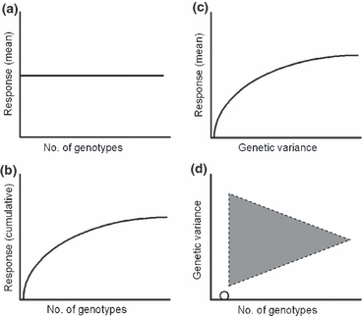
Challenges
Being able to culture adequate daphnia in a month
Experiment might need to run longer than 6 weeks but have to stop by March
In high diversity tank, every seeded indiv. is a distinct genotype
Lack of monocultures for all genotypes
  Need a means to set a baseline level of effect without genetic diversity
Is the spatial scale appropriate?
Hughes, A.R., et al. (2008) Ecology Letters.

Slide 14
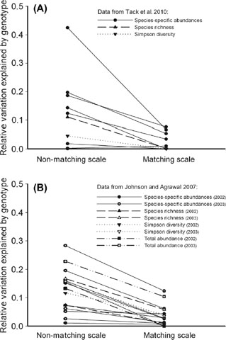
Challenges
Being able to culture adequate daphnia in a month
Experiment might need to run longer than 6 weeks but have to stop by March
In high diversity tank, every seeded indiv. is a distinct genotype
Lack of monocultures for all genotypes
  Need a means to set a baseline level of effect without genetic diversity
Is the spatial scale appropriate?
Tack, A.J.M., M.T.J. Johnson, and T. Roslin. (2012) Oikos.

